Slide 1
Powering Up Your Leadership Pipeline: How Top Companies Get It Right Veronica S. Harvey, Ph.D. Partner, Aon Hewitt March 31, 2015
Notes:
Can be a L1A, L1B, L1C or L2 image
The image needs to be cropped within the current window specs
Try to use the same categories of images in your various divider slides (i.e. all L2)

Slide 2
Objectives for Today
1 What is Aon Hewitt Top Companies for Leaders ® About?
2 What Differentiates the Top Companies?
3 What Can We Learn About Leadership Assessment from Companies Who Do it Best?
4 Questions & Wrap-up

Slide 3
What is Aon Hewitt Top Companies for Leaders® About?

Slide 4
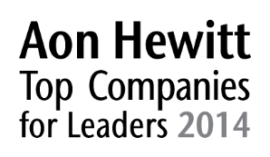
Aon Hewitt’s Top Companies for Leaders® Research
Longest running, most comprehensive global study on leadership and talent in the market
Examines the link between leadership practices and financial results
Investigates how organizations set strategies, assess, select, develop, and reward leaders
Analyzes the execution of leadership practices, as well as the strategy that guides it

Slide 5
Aon Hewitt’s Top Companies for Leaders® Methodology
Survey
Over 1,500 survey data points capturing organizational program and practice detail
Financial
Comprehensive analysis on 5-year financial performance against industry peers
Selection
Independent panel of judges uses inputs to select and rank the winners
Reputation
Review of all negative publicity and litigations for finalists
Interview
Over 300 executive and C-suite interviews capturing the execution details surrounding their talent
For more information on Aon Hewitt Top Companies for Leaders ® including a highlights report visit our website: www.aon.com/topcompanies
Notes:
180 Global Participants in 24 countries
Participants completed detailed questionnaire. Aon Hewitt analyzed responses for strong leadership practices
115 Global Finalists
In-depth interviews with HR leaders, CEOs and senior executives (we interviewed nearly 70% of corporate CEOs in the finalist organizations)
Aon Hewitt scored data by assigning points to questions and responses
Companies screened for financial performance relative to industry – 2 growth (CAGR for Sales or Revenues, EBIT and 2 return: ROE and ROA)
18-month bad-press scan
Program collateral submitted
53 Winners
Independent panel of judges gathered in North America, India, South East Asia, and Australia markets to select and rank top companies. Market winners and finalists from Europe and Latin America rolled up for global consideration
Global (25)
North America (25) + 4 Special Recognition
India (4) + 2 MNC + 1 Special Recognition
SEA (6) + 2 MNC + 2 Special Recognition
ANZ (2) + 1 MNC

Slide 6
Aon Hewitt Top Companies for Leaders®
Global Winners
North America Winners
1. | General Electric Company | 14. | ArcelorMittal
2. | International Business Machines | 15. | WEG
3. | Hindustan Unilever Limited | 16. | Deere & Company
4. | General Mills, Inc. | 17. | Eli Lilly and Company
5. | ICICI Bank Ltd. | 18. | DBS Group Holdings Ltd
6. | The Procter and Gamble Company | 19. | Royal Dutch Shell plc
7. | Colgate-Palmolive Company | 20. | Singapore Telecommunications Limited
8. | 3M | 21. | Sonoco Products Company
9. | Novartis AG | 22. | Sime Darby Berhad
10. | Mahindra Group | 23. | Cargill, Inc.
11. | McDonald's Corporation | 24. | American Express Company
12. | Intel Corporation | 25. | Raytheon Company
13. | Whirlpool Corporation
1. | International Business Machines | 14. | V.F. Corporation
2. | General Mills, Inc. | 15. | The Boeing Company
3. | General Electric Company | 16. | American Express Company
4. | The Procter & Gamble Company | 17. | AT&T, Inc.
5. | Colgate-Palmolive Company | 18. | Capital One Financial Corporation
6. | 3M | 19. | UnitedHealth Group Incorporated
7. | McDonald’s Corporation | 20. | Kiewit Corporation
8. | Intel Corporation | 21. | Fluor Corporation
9. | Whirlpool Corporation | 22. | Raytheon Company
10. | Deere & Company | 23. | Yum! Brands, Inc.
11. | Eli Lilly and Company | 24. | The Goodyear Tire & Rubber Company
12. | Sonoco Products Company | 25. | Owens Corning
13. | Cargill, Inc.

Slide 7
What Differentiates the Top Companies

Slide 8
What it Takes to be a Top Company in 2015 and Beyond
4
+
5
+
3
=
Four Disciplines
Five Fundamentals
Three Leader Attributes
25
Top Companies for Leaders

Slide 9
What Differentiates Top Companies?
For more than a decade, the Aon Hewitt Top Companies for Leaders® research shows what truly separates top companies from other participating organizations
Leaders lead the way
Practical and aligned programs and practices
1
Senior leaders have a passionate and visible commitment to developing leaders
3
Leadership strategy clearly reflects the overall business strategy
2
An intense focus on talent permeates every level of the organization
4
The development of leaders is an institutionalized practice and mindset
Unrelenting focus on talent
When leadership becomes a way of life
Notes:
This slide is a summary of the longitudinal findings that separate the TCFLs from the rest. The 2014 insights continue to highlight the importance of these four factors. However, the adaptation of the design and delivery of programs aligned to these is starting to be impacted by the external environment and by trends in technology and innovation.
- Most companies today have the basics in place when it comes to leadership
- What differentiates the Top Companies from the rest are we what we call the 4 leadership disciplines. The first 3 of these emerged after our first studies in 2001-2005, and in 2009 we saw the 4th discipline (what we often refer to as the DNA) arise. It is the culmination of the first 3, and only when these are executed well over time do they become part of the organizational fabric/culture.
Leaders Lead the Way
- Senior leaders take personal responsibility for cultivating and engaging talent; they understand that the emotional side of leadership is powerful and they act on it;
transfer of wisdom and “teaching” are a way of leading
- Leadership development is at the top of the Board’s, CEO’s and senior team’s agenda and priorities, and they are actively involved in the key leadership processes
- Leaders model the behavior they expect of others and are dedicated to the development of talent and building a diverse pipeline of leaders; accountability is driven from the top
Unrelenting focus on Talent
Developing talent is seen as a mission-critical business process
Talent = competitive advantage; leaders are measured on their ability to develop and inspire others
Talent is a corporate asset and moved across geographies; Differential investment in top talent is a given
Involves more than just developing people, but also how you hire, coach, promote, and reward.
Practical and Aligned Programs and Practices
Comprehensive leadership practices are aligned with business goals; strategy dictates development.
Development is multifaceted and reaches all levels within the organization; assessment and development are customized to address the needs of different groups
Relevance and scalability are key; scrutinize the actual shift in leader effectiveness
When Leadership Becomes a Way of Life It is a way of behaving that is woven into every aspect of the business—the culture, the way decisions are made, and the growth strategy
Think in terms of rhythms, not initiatives. There is no “end state” in mind. Once a rhythm is in place, sustain it as an ongoing discipline
A talent-mindset permeates throughout the organisation, its leadership, and ultimately, its results

Slide 10
Five Fundamentals that Set Top Companies Apart in 2015
Impact and results
Leadership and talent mindset:
Adaptable
Innovative
Reinvention; raising the bar
Customer-centric
Focus on the talent pipeline
Pervasive
Comprehensive
Integrated
Consistent
Simple and scalable
Sustainable
Clear alignment of business strategy to talent strategy and practices
CEO, Board of Directors, and senior management involvement
Notes:
Judge’s criteria also included: Financial performance (could be discussed under Impact and Results)
Reputation for leadership development—where would you send someone to learn about leadership if given your choice?
Global Perspective and Reach (global TC’s)

Slide 11
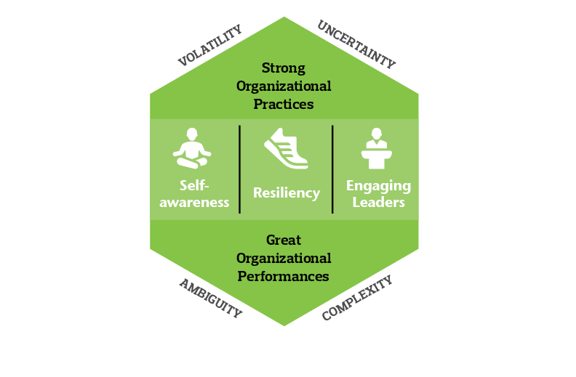
Three Leader Attributes DNA of Aon Hewitt Top Companies for Leaders®
Notes:
VUCA
Cargill: “A wide acceptance of complexity and ambiguity in the last two years. We’ve called on leadership to lead through turbulent times. Agility is very critical. It is a rapidly changing world. Principles-based, performance drive; need to have the freedom to operate” (BU Leader) –Cargill
Hindustan Unilever: “A leader in my organization is a person with purpose, person with values, huge amount of passion for consumers and brands, very result oriented. He is the leader of the business and the leader of the people, he knows what to do and he knows how to get the work done. He should demonstrate behavior needed in todays’ world of adaptability, of resilience, systemic thinking and practice responsibility and accountability.” (CEO)
Self-Awareness
Hindustan Unilever: Each leader at chooses his/her own leadership style to lead the team. The Talent Organizational Study is conducted to check if the selected strategy is working for the team. They appreciate the feedback and view it as a way to identify required improvement areas. Strategies are discussed during an HR Planning exercise annually with top management. Leaders are held accountable for any delay in the process.
GE: Development Course examples include: Integrated Learning (programs infuse logic and linear thinking with spontaneity and creativity, drawing upon a range of disciplines). Aim: to build adaptive leadership capable of navigating uncertainty. Mindfulness and Reflection. Comprehensive approach elevates and honors the human dimensions of the leadership journey-learning styles, personality traits and passions-to help participants connect “who they are” to “how they lead.”” –GE
Resiliency
GE: “Fast Works – A new process tool where the notion is ‘try things, pivot, try them again. Start small but start fast, learning’. Using this to drive this notion of iteration and failure down into the organization. Fast Works has introduced speed; exploration leadership allows us to examine how you lead in a changing environment.”
Mahindra & Mahindra: “The RISE pillars are the basis for the 6 pillars of leadership behavior that the company wants leaders to embody: (1) ability to make use of both left and right brain; (2) multipliers of passion, energy, and sense of ownership; (3) ability to manager fear and leverage failure; (4) mindfulness in the age of distractions; (5) global mindset, openness to changes; (6) comfort with ambiguity, and creating a culture of trust.” –Mahindra & Mahindra
Engaging Leaders:
Capital One: “Engaging leaders at Capital One are aspirational by showing an example or ‘painting an image’ of what the company aims to do in terms of customer satisfaction. Capital One’s approach is dare to dream, disrupt, and deliver in a better way. Leaders must exemplify this goal.” (CHRO) They must hold themselves personally accountable to taking the high road in everything that they do. In their personality, they elevate others by speaking of their achievements with as much pride as if they did it themselves and they inspire the imaginations of others around them by having a dream and vision that is contagious.
Intel: Engaged leaders are market-oriented, inspired by the company’s challenges, seek to learn and grow amidst the biggest challenges, are candid and open about those challenges, and can define innovative solutions and explain them to people in such a way that they become confident in Intel’s ability to win. Engaged leaders are “storytellers” (HR) connected to a customer-centric solution and are proud of the legacy of Intel.

Slide 12
Laying the Foundation for Success: What Companies Must Get Right
Leadership Strategy & Accountability
Metrics
Attracting Leaders
Seamless Execution
Succession Management
Leadership Assessment
High Potentials
Leadership Development
Notes:
Strategy & Accountability: Programs are strategically tied to the goals, values and culture of the organization. Leaders demonstrate and are held accountable for strategically-driven behaviors
Attracting Leaders: Leaders are engaged and values-driven. Companies utilize a consistent and rigorous approach to selection and onboarding
Leadership Assessment: Valid and objective assessments to understand capabilities, guide development, inform succession plans
Leadership Development: Provide accelerated development through meaningful, experiential, relational, and traditional processes
High Potentials: Conduct robust talent reviews to consistently define, identify, calibrate and develop high-potential and critical talent
Succession Management: Maintain a deep and robust talent pipeline via succession management
Metrics: Utilize metrics to track progress, evaluate effectiveness and drive desired results

Slide 13
What Can We Learn About Leadership Assessment from Companies Who Do it Best?

Slide 14
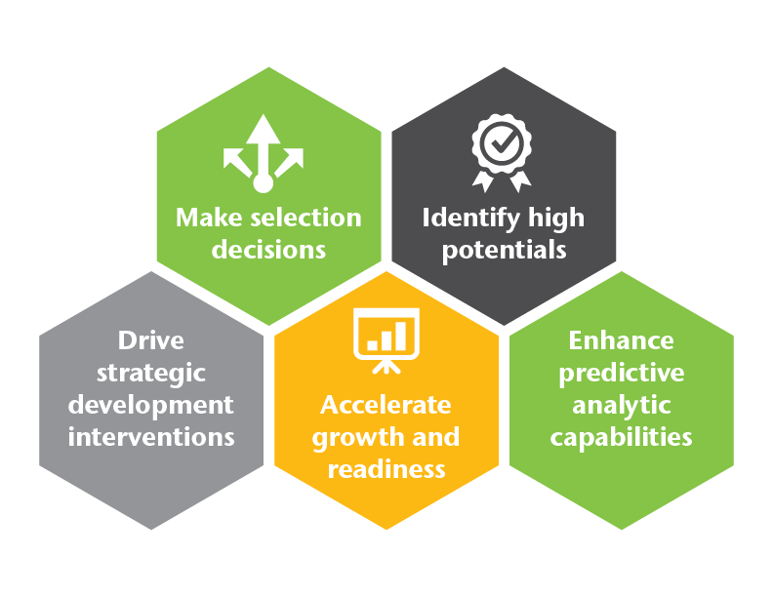
The Discipline of Assessment

Slide 15
Aon Hewitt Top Companies for Leaders® Use Assessment to Create a Strong Leadership Pipeline
Top companies | What they do differently…. | All others
100% | Have formal strategies for assessing leaders | 80%
100% | Use assessment to identify deficiencies in leadership skill sets | 76%
96% | Develop accelerated development plans based on assessment information | 71%

Slide 16
Use of Assessment is Related to Financial results
15%
higher relative performance in profitability when assessment conducted at senior management levels
35%
higher relative performance in profitability when assessment conducted at middle management levels

Slide 17
Aon Hewitt Top Companies for Leaders® Incorporate Assessment at Every Leadership Level
Percent of Top Companies
Assessments Tools

Slide 18
Guiding Principal #1: Assess Potential to “Make the Curve” at Each Leadership Level
Enterprise Manager
Group Manager
Business Manager
Functional Manager
Manage Managers
First-Level Manager
Assess
Manage Self

Slide 19
Guiding Principle #2: Align Assessment Practices with Organizational Strategy and Context
Leadership behavior and styles are differentially effective depending on the situation (Vroom and Jargon, 1980)
Overlooking context is one of the four key reasons that leadership development programs fail (McKinsey, 2014?)
Top companies | What they do differently…. | All others
88% | Explicitly align assessment practices with organizational strategy | 41%

Slide 20
Guiding Principle #3: Use a Variety of Valid, Objective Assessment Techniques
Percent of Companies
Assessments Tools

Slide 21
Assessment Centers that Integrate Multiple Techniques are Particularly Valid
Operational Validity Estimates
(Relationship Between Performance and Assessment)
* Please note that the validity data comes from a wide range of different empirical, review, and meta-analytic articles.

Slide 22
Guiding Principle #4: Integrate Assessments Across Talent Practices
Percent of Companies
Types of Talent Practices

Slide 23
Competencies Provides a Common Denominator
Percent of Top Companies
Assessments Tools

Slide 24
Guiding Principle #5: Aim to Make Assessments and Engaging
Reflect the values and culture of the organization
Viewed as fair and impartial
Clearly related to the work of leadership (“high-fidelity”)
Entertaining and engaging
Notes:
Reactions to technologically innovative assessments tend to be positive, particularly multi-media assessments

Slide 25
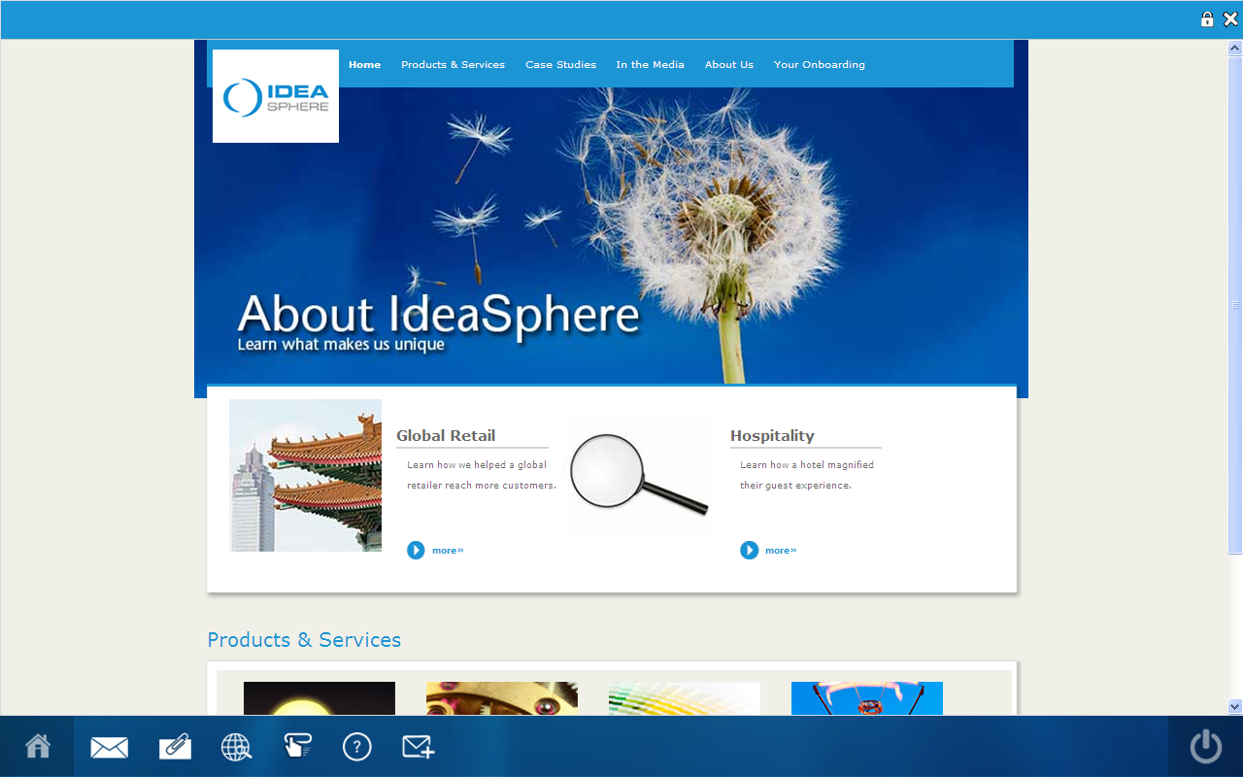
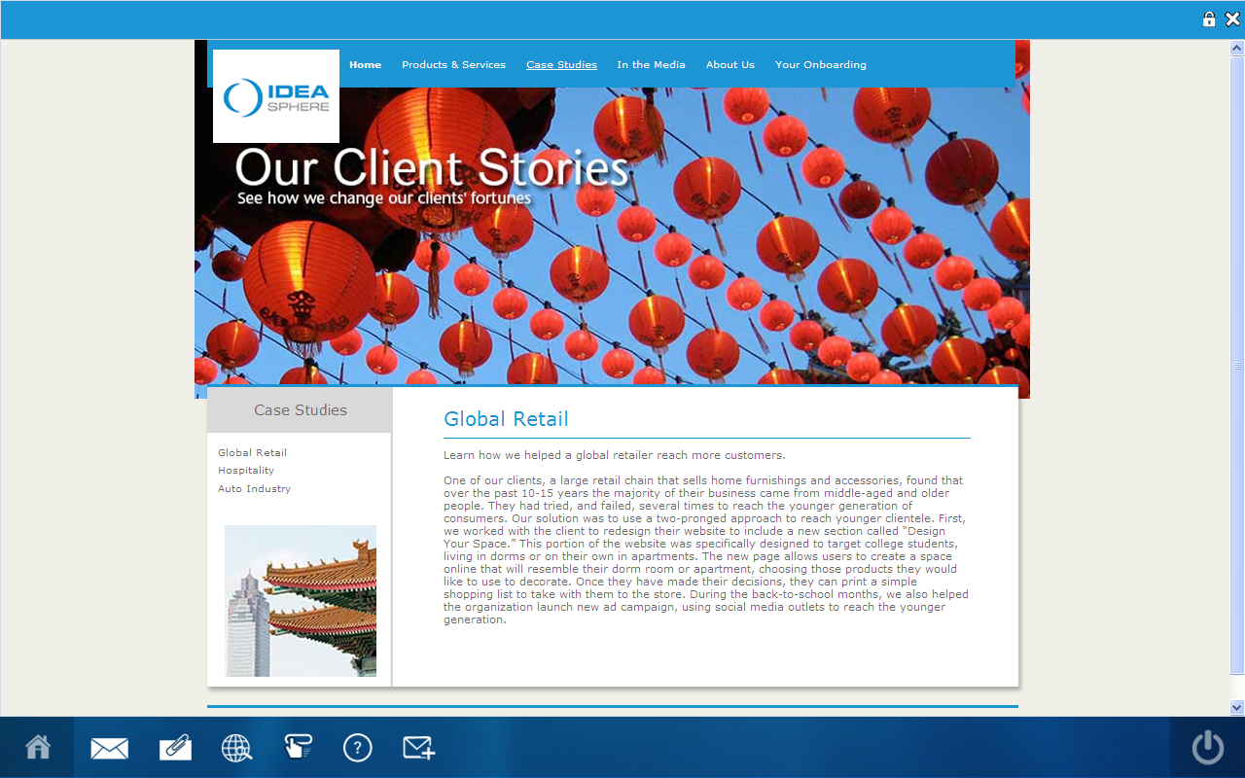
An Example of a High-Fidelity Business Simulation
Simulation Home Page
Simulation Content Page

Slide 26
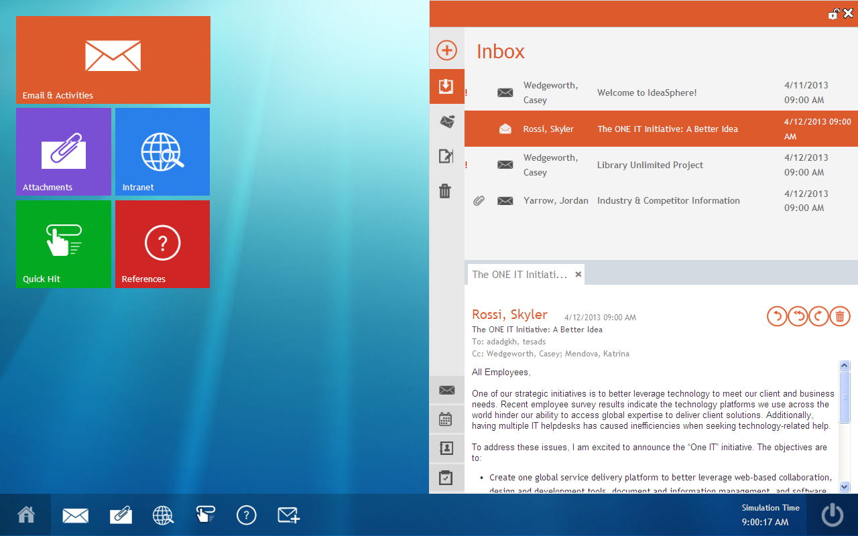
An Example of a High-Fidelity Business Simulation

Slide 27
Guiding Principle #6: Ensure Assessment Processes are Practical and Sustainable
Can the assessment process be tailored?
Will the process be scalable?
Can assessments be implemented virtually?
Are administrative processes efficient?
Is the process globally relevant?
Can different types of assessments be integrated?
How quickly can feedback reports be received?
Are feedback reports easily understood?
Do feedback reports reflect the organizations competencies?
Is feedback linked to development resources?

Slide 28
Summary of Guiding Principles
1 Assess potential to “make the curve” at each leadership level
2 Align assessment practices with organizational strategy and context
3 Use a variety of valid, objective assessment techniques
4 Integrate assessments across talent management practices, with competencies as the common denominator
5 Aim to make assessments realistic and engaging
6 Ensure assessment processes are practical and sustainable

Slide 29
Questions
Notes:
Can be a L1A, L1B, L1C or L2 image
The image needs to be cropped within the current window specs
Try to use the same categories of images in your various divider slides (i.e. all L2)

Slide 30
For More Information
Veronica S. Harvey, Ph.D. Partner
Aon Hewitt
Performance, Rewards & Talent Practice
+1.281.610.2049
veronica.harvey@aonhewitt.com
For more information on Aon Hewitt Top Companies for Leaders ® including a highlights report visit our website: www.aon.com/topcompanies
For more information on LEADeR® visit our website: www.aon.com/leader

Slide 31
About Aon Hewitt
Aon Hewitt empowers organizations and individuals to secure a better future through innovative talent, retirement and health solutions. We advise, design and execute a wide range of solutions that enable clients to cultivate talent to drive organizational and personal performance and growth, navigate retirement risk while providing new levels of financial security, and redefine health solutions for greater choice, affordability and wellness. Aon Hewitt is the global leader in human resource solutions, with over 30,000 professionals in 90 countries serving more than 20,000 clients worldwide. For more information on Aon Hewitt, please visit www.aonhewitt.com.
© 2015 Aon plc This document is intended for general information purposes only and should not be construed as advice or opinions on any specific facts or circumstances. The comments in this summary are based upon Aon Hewitt's preliminary analysis of publicly available information. The content of this document is made available on an “as is” basis, without warranty of any kind. Aon Hewitt disclaims any legal liability to any person or organization for loss or damage caused by or resulting from any reliance placed on that content. Aon Hewitt reserves all rights to the content of this document.

